Slide 1

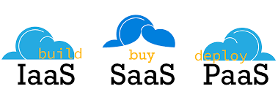
Course code : CSE4001 Course title : Cloud Computing Module : 5 Topic : 1
Cloud Delivery Models

Slide 2
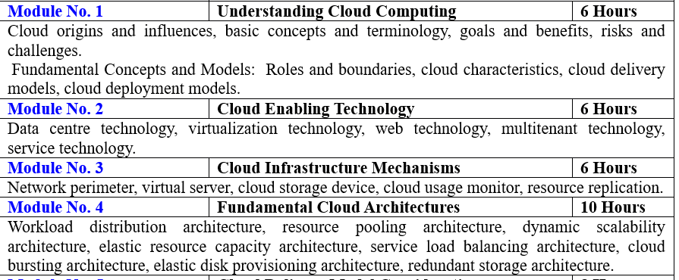

Slide 3
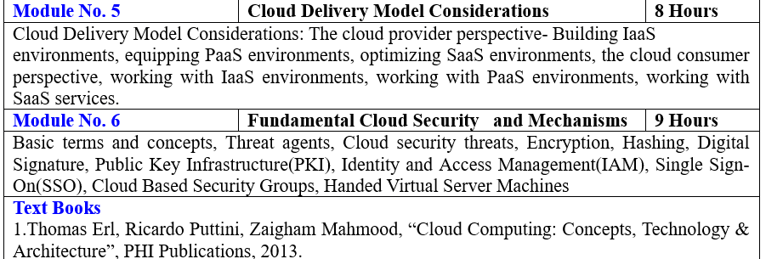

Slide 4
Objectives
This session will give the knowledge about
14.1 Cloud Delivery Models: The Cloud Provider Perspective
14.2 Cloud Delivery Models: The Cloud Consumer Perspective
14.3 Case Study Example

Slide 5
The Cloud Provider Perspective
Building IaaS Environments
Equipping PaaS Environments
Optimizing SaaS Environments
The Cloud Consumer Perspective
Working with IaaS Environments
Working with PaaS Environments
Working with SaaS Services

Slide 6
Cloud Providers ?
A cloud provider is a person, or an organization; it is the entity responsible for making a service available to interested parties.
A Cloud Provider acquires and manages the computing infrastructure required for providing the services, runs the cloud software that provides the services, and makes arrangement to deliver the cloud services to the Cloud Consumers through network access.

Slide 7
Cloud Consumer ?
The cloud consumer is the principal stakeholder for the cloud computing service. A cloud consumer represents a person or organization that maintains a business relationship with, and uses the service from a cloud provider.
The cloud consumer may be billed for the service provisioned, and needs to arrange payments accordingly.
Cloud consumers need SLAs to specify the technical performance requirements fulfilled by a cloud provider. SLAs can cover terms regarding the quality of service, security, remedies for performance failures.

Slide 8
List of Cloud Service Providers
Amazon Web Service (AWS)
Microsoft Azure
Google Cloud Platform
IBM Cloud Services
Adobe Creative Cloud
Kamatera
VMware
Rackspace
Red Hat
Salesforce
Oracle Cloud
SAP
Verizon Cloud
Navisite
Dropbox

Slide 9
The Cloud Provider Perspective
Explores the architecture and administration of IaaS, PaaS, and SaaS
The integration and management of these cloud-based environments as part of greater environments.
How they can relate to different technologies and cloud mechanism combinations are examined.

Slide 10
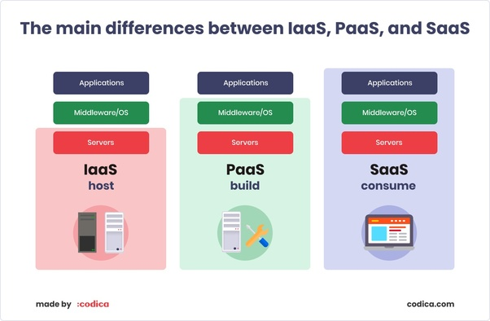
Iaas,Paas, Saas ?

Slide 11
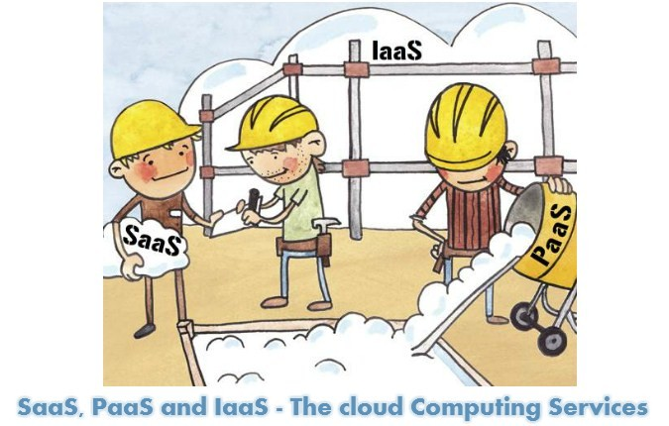

Slide 12
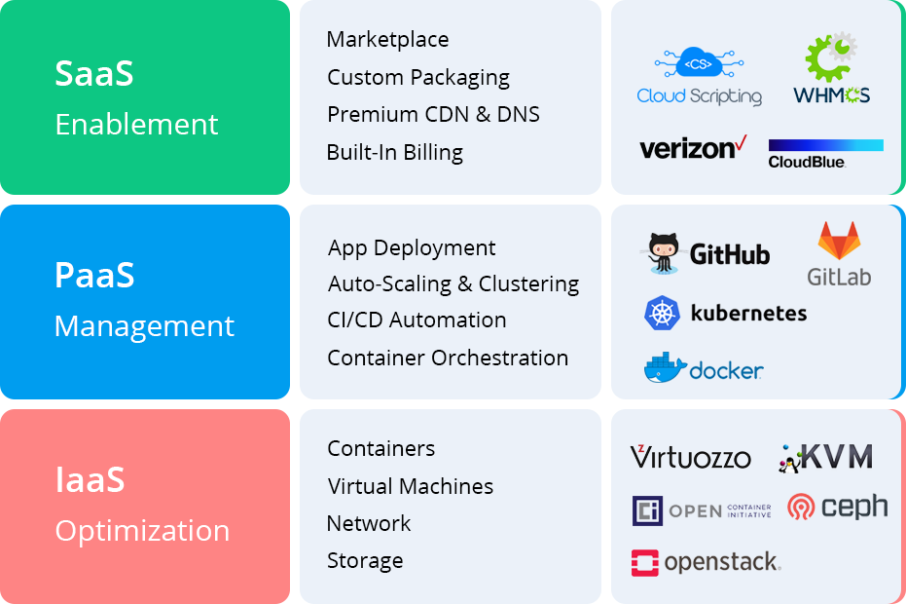
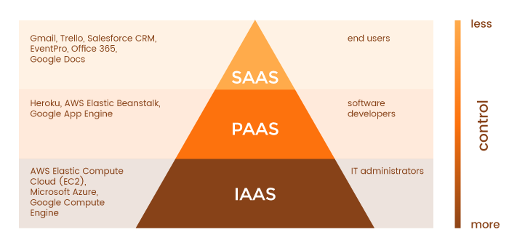
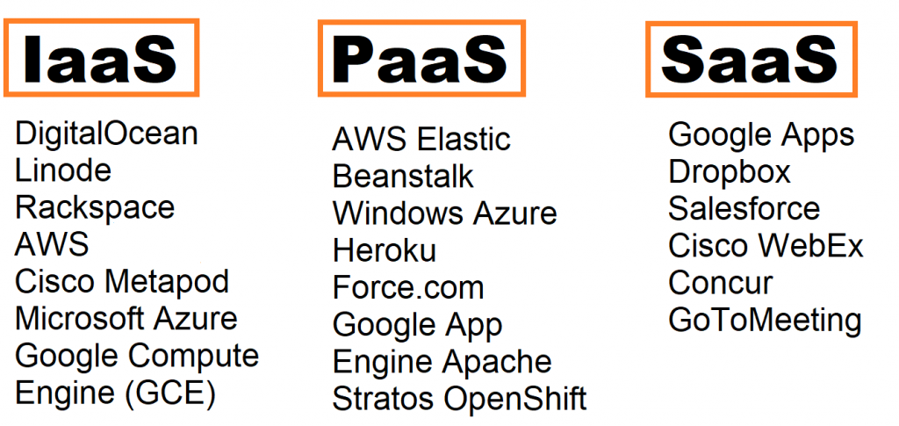

Slide 13
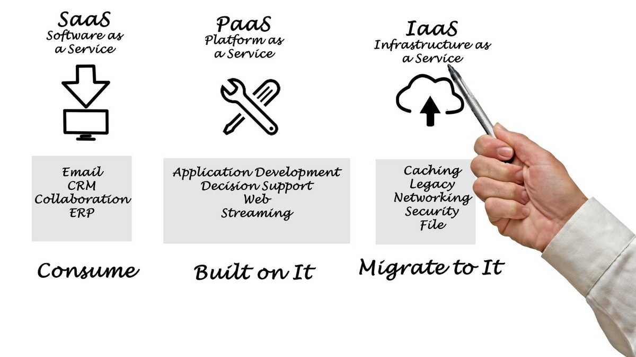

Slide 14
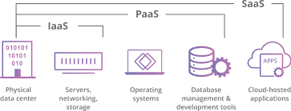
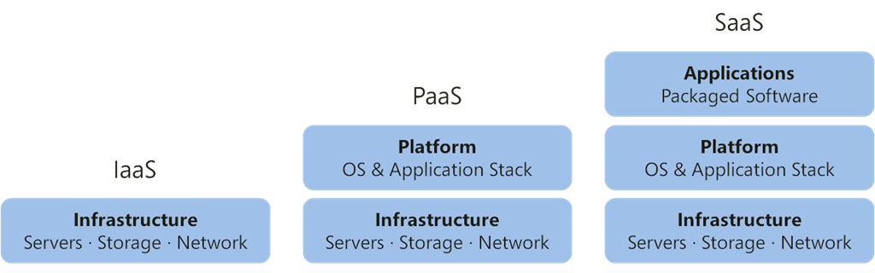

Slide 15
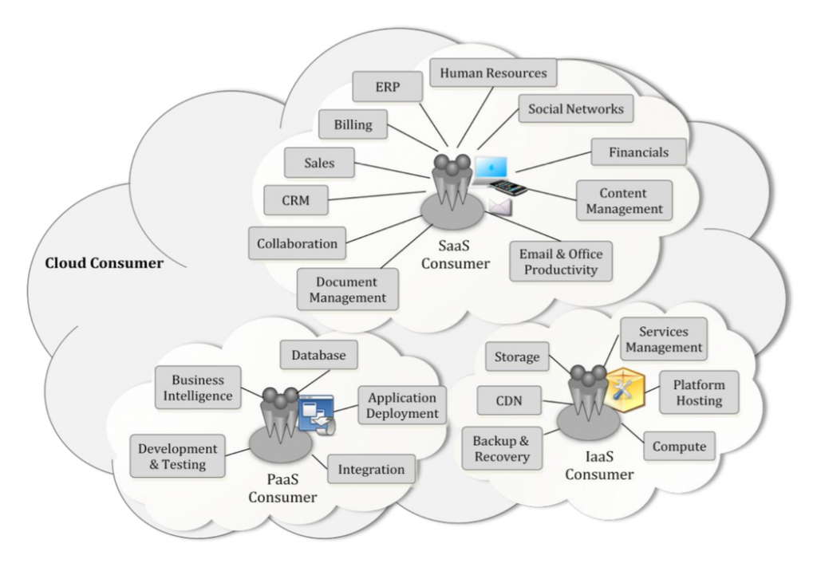
Examples of Cloud Services
Some example cloud services available to a cloud consumer are listed below:

Slide 16
1. Building IaaS Environments
The virtual server and cloud storage device mechanisms represent the two most fundamental IT resources that are delivered as part of a standard rapid provisioning architecture within IaaS environments.
They are offered in various standardized configurations that are defined by the following properties:
operating system
primary memory capacity
processing capacity
virtualized storage capacity

Slide 17
Memory and virtualized storage capacity is usually allocated with increments of 1 GB to simplify the provisioning of underlying physical IT resources.
When limiting cloud consumer access to virtualized environments, IaaS offerings are preemptively assembled by cloud providers via virtual server images that capture the pre-defined configurations.
Some cloud providers may offer cloud consumers direct administrative access to physical IT resources, in which case the bare-metal provisioning architecture may come into play.
Snapshots can be taken of a virtual server to record its current state, memory, and configuration of a virtualized IaaS environment for backup and replication purposes, in support of horizontal and vertical scaling requirements.
For example, a virtual server can use its snapshot to become reinitialized in another hosting environment after its capacity has been increased to allow for vertical scaling. The snapshot can alternatively be used to duplicate a virtual server. The management of custom virtual server images is a vital feature that is provided via the remote administration system mechanism. Most cloud providers also support importing and exporting options for custom-built virtual server images in both proprietary and standard formats.

Slide 18
Aspects of Cloud Providers
Data Centre
Scalability and Reliability
Monitoring
Security

Slide 19
1. Data Centres
Cloud providers can offer IaaS-based IT resources from multiple geographically diverse data centers, which provides the following primary benefits:
• Multiple data centers can be linked together for increased resiliency(free from failure). Each data center is placed in a different location to lower the chances of a single failure forcing all of the data centers to go offline simultaneously.
• Connected through high-speed communications networks with, low latency(less delay) data centers can perform load balancing, IT resource backup and replication, and increase storage capacity, while improving availability and reliability. Having multiple data centers spread over a greater area further reduces network latency.
• Data centers that are deployed in different countries make access to IT resources more convenient for cloud consumers that are constricted by legal and regulatory requirements.

Slide 20
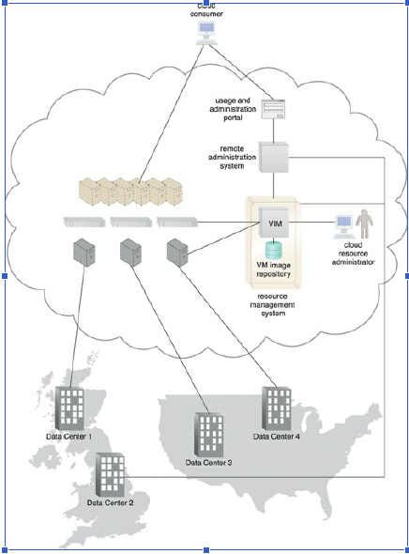
Example of a cloud provider that is managing four data centers that are split between two different geographic regions.

Slide 21
When an IaaS environment is used to provide cloud consumers with virtualized network environments, each cloud consumer is segregated into a tenant environment that isolates IT resources from the rest of the cloud through the Internet.
VLANs and network access control software collaboratively realize the corresponding logical network perimeters.

Slide 22
2. Scalability and Reliability
Within IaaS environments, cloud providers can automatically provision virtual servers via the dynamic vertical scaling type of the dynamic scalability architecture. This can be performed through the VIM, as long as the host physical servers have sufficient capacity.
The VIM can scale virtual servers out using resource replication as part of a resource pool architecture, if a given physical server has insufficient capacity to support vertical scaling.
The load balancer mechanism, as part of a workload distribution architecture, can be used to distribute the workload among IT resources in a pool to complete the horizontal scaling process.

Slide 23
Manual scalability requires the cloud consumer to interact with a usage and administration program to explicitly request IT resource scaling.
In contrast, automatic scalability requires the automated scaling listener to monitor the workload and reactively scale the resource capacity.
This mechanism typically acts as a monitoring agent that tracks IT resource usage in order to notify the resource management system when capacity has been exceeded.

Slide 24
Replicated IT resources can be arranged in high-availability configuration that forms a failover system for implementation via standard VIM features.
Alternatively, a high-availability/high-performance resource cluster can be created at the physical or virtual server level, or both simultaneously. The multipath resource access architecture is commonly employed to enhance reliability via the use of redundant access paths, and some cloud providers further offer the provisioning of dedicated IT resources via the resource reservation architecture.

Slide 25
3. Monitoring
Cloud usage monitors in an IaaS environment can be implemented using the VIM or specialized monitoring tools that directly comprise and/or interface with the virtualization platform. Several common capabilities of the IaaS platform involve monitoring:
Virtual Server Lifecycles – Recording and tracking uptime periods and the allocation of IT resources, for pay-per-use monitors and time-based billing purposes.
Data Storage – Tracking and assigning the allocation of storage capacity to cloud storage devices on virtual servers, for pay-per-use monitors that record storage usage for billing purposes.
Network Traffic – For pay-per-use monitors that measure inbound and outbound network usage and SLA monitors that track QoS metrics, such as response times and network losses.
Failure Conditions – For SLA monitors that track IT resource and QoS metrics to provide warning in times of failure.
Event Triggers – For audit monitors that appraise and evaluate the regulatory compliance of select IT resources.
Monitoring architectures within IaaS environments typically involve service agents that communicate directly with backend management systems.

Slide 26
4.Security
Cloud security mechanisms that are relevant for securing IaaS environments include:
encryption, hashing, digital signature, and PKI mechanisms for overall protection of data transmission.
IAM and SSO mechanisms for accessing services and interfaces in security systems that rely on user identification, authentication, and authorization capabilities
cloud-based security groups for isolating virtual environments through hypervisors and network segments via network management software
hardened virtual server images for internal and externally available virtual server environments
various cloud usage monitors to track provisioned virtual IT resources to detect abnormal usage patterns
*IAM-Identify and Access Management , SSO-Single Sign-on

Slide 27
Session 2
Equipping PaaS Environments

Slide 28
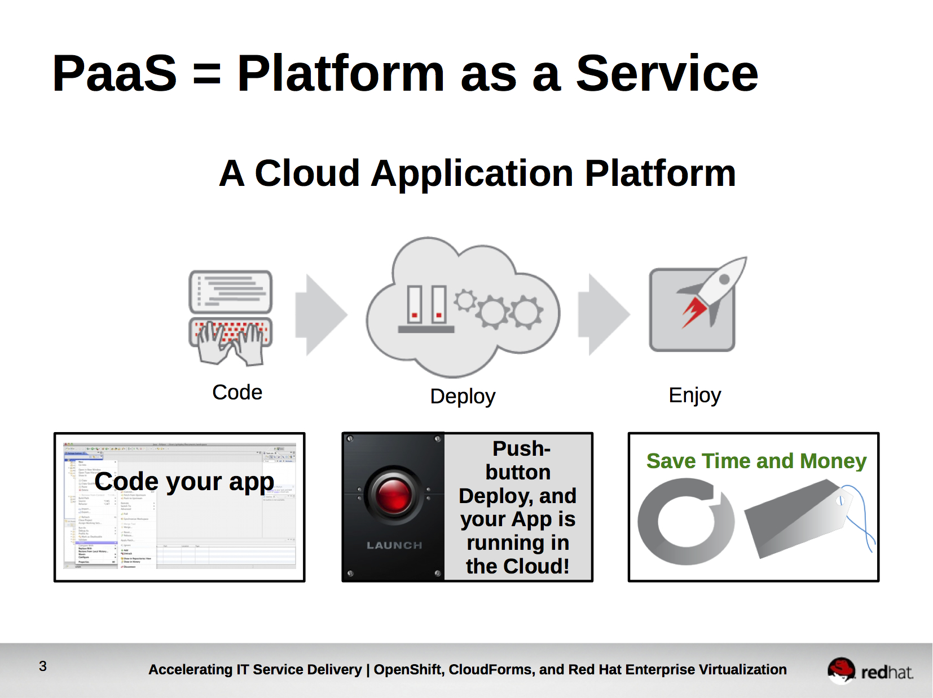
2. Equipping PaaS Environments(deploy)

Slide 29
PaaS environments typically need to be ready with a selection of application development and deployment platforms in order to accommodate different programming models, languages, and frameworks.
A separate ready-made environment is usually created for each programming stack that contains the necessary software to run applications specifically developed for the platform.
Each platform is accompanied by a matching SDK and IDE, which can be custom-built or enabled by IDE plugins supplied by the cloud provider. IDE toolkits can simulate the cloud runtime locally within the PaaS environment and usually include executable application servers.
The security restrictions that are inherent to the runtime are also simulated in the development environment, including checks for unauthorized attempts to access system IT resources.

Slide 30
Cloud providers often offer a resource management system mechanism that is customized for the PaaS platform so that cloud consumers can create and control customized virtual server images with ready-made environments.
This mechanism also provides features specific to the PaaS platform, such as managing deployed applications and configuring multitenancy. Cloud providers further rely on a variation of the rapid provisioning architecture known as platform provisioning, which is designed specifically to provision ready-made environments.

Slide 31
Aspects of Cloud Providers
Scalability and Reliability
Monitoring
Security

Slide 32
1. Scalability and Reliability
The scalability requirements of cloud services and applications that are deployed within PaaS environments are generally addressed via dynamic scalability and workload distribution architectures that rely on the use of native automated scaling listeners and load balancers.
The resource pooling architecture is further utilized to provision IT resources from resource pools made available to multiple cloud consumers.
Cloud providers can evaluate network traffic and server-side connection usage against the instance’s workload, when determining how to scale an overloaded application as per parameters and cost limitations provided by the cloud consumer.
Alternatively, cloud consumers can configure the application designs to customize the incorporation of available mechanisms themselves.

Slide 33
The reliability of ready-made environments and hosted cloud services and applications can be supported with standard failover system mechanisms (Figure 14.2), as well as the non-disruptive service relocation architecture, so as to shield cloud consumers from failover conditions.
The resource reservation architecture may also be in place to offer exclusive access to PaaS-based IT resources. As with other IT resources, ready-made environments can also span multiple data centers and geographical regions to further increase availability and resiliency.

Slide 34
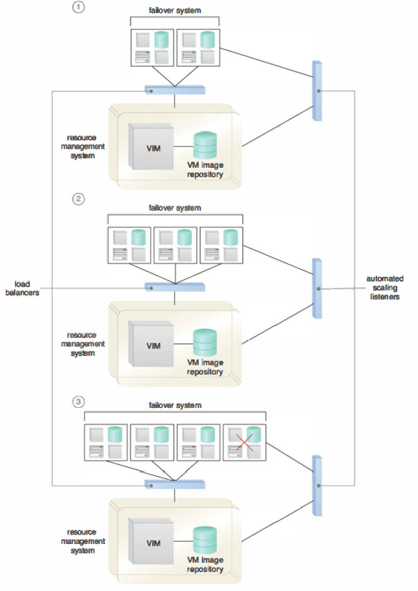
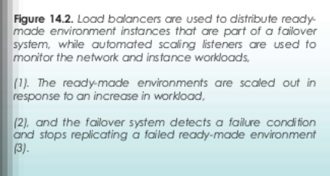
reliability of ready-made environments

Slide 35
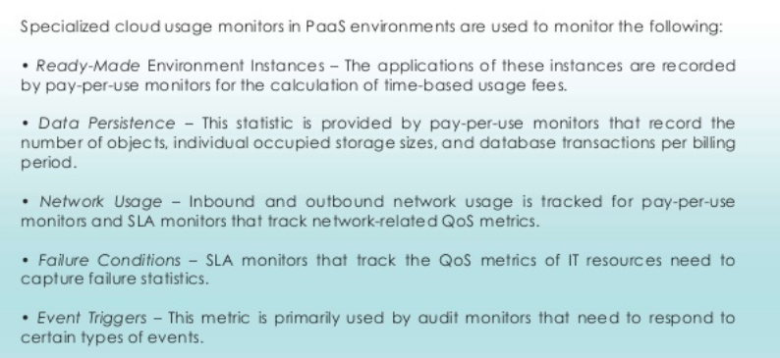
2.Monitoring

Slide 36
3.Security
The PaaS environment, by default, does not usually introduce the need for new cloud security mechanisms beyond those that are already provisioned for IaaS environments.

Slide 37
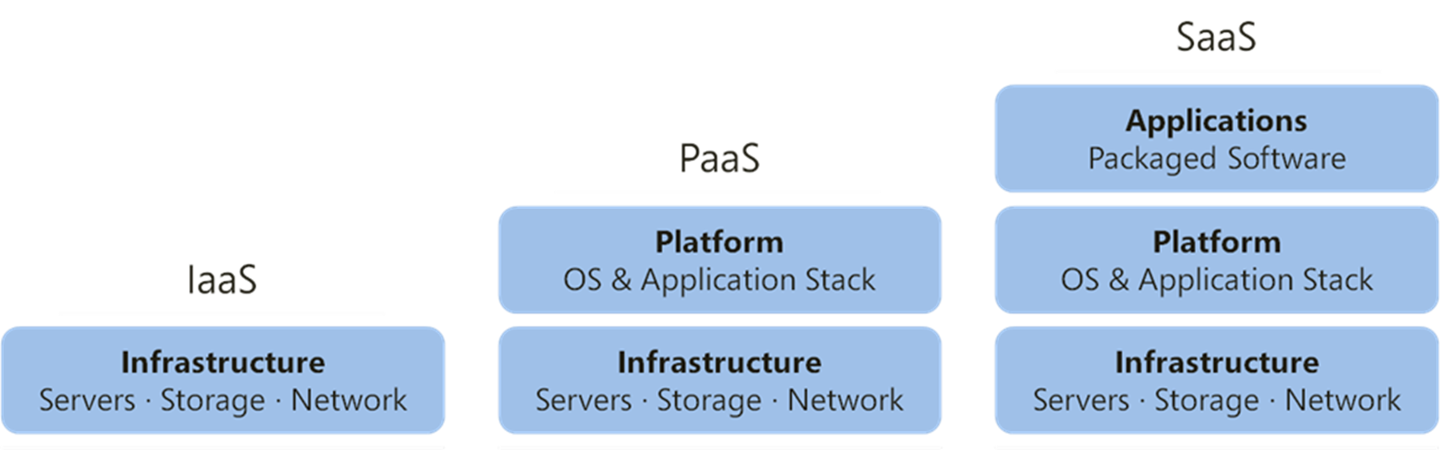
Day 2
Optimizing SaaS Environments

Slide 38
In SaaS implementations, cloud service architectures are generally based on multitenant environments that enable and regulate concurrent cloud consumer access (Figure 14.3).
SaaS IT resource segregation does not typically occur at the infrastructure level in SaaS environments, as it does in PaaS environments.

Slide 39
Figure 14.3 The SaaS-based cloud service is hosted by a multitenant environment deployed in a high-performance virtual server cluster. A usage and administration portal is used by the cloud consumer to access and configure the cloud service.

Slide 40
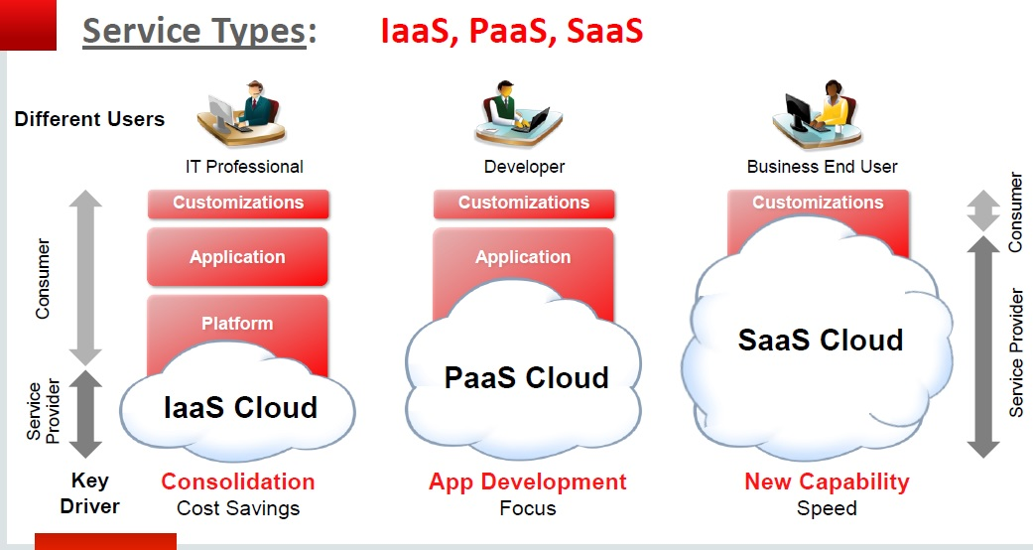
SaaS implementations rely heavily on the features provided by the native dynamic scalability and workload distribution architectures, as well as non-disruptive service relocation to ensure that failover conditions do not impact the availability of SaaS-based cloud services.
However, it is vital to acknowledge that, unlike the relatively vanilla designs of IaaS and PaaS products, each SaaS deployment will bring with it unique architectural, functional, and runtime requirements. These requirements are specific to the nature of the business logic the SaaS-based cloud service is programmed with, as well as the distinct usage patterns it is subjected to by its cloud service consumers.

Slide 41
For example, consider the diversity in functionality and usage of the following recognized online SaaS offerings:
• collaborative authoring and information-sharing (Wikipedia, Blogger)
• collaborative management (Zimbra, Google Apps)
• conferencing services for instant messaging, audio/video communications (Skype, Google Talk)
• enterprise management systems (ERP, CRM, CM)
• file-sharing and content distribution (YouTube, Dropbox)
• industry-specific software (engineering, bioinformatics)
• messaging systems (e-mail, voicemail)
• mobile application marketplaces (Android Play Store, Apple App Store)
• office productivity software suites (Microsoft Office, Adobe Creative Cloud)
• search engines (Google, Yahoo)
• social networking media (Twitter, LinkedIn)

Slide 42
Now consider that many of the previously listed cloud services are offered in one or more of the following implementation mediums:
• Mobile application
• REST service
• Web service

Slide 43
Each of these SaaS implementation mediums provide Web-based APIs for interfacing by cloud consumers.
Examples of online SaaS-based cloud services with Web-based APIs include:
• Electronic payment services (PayPal)
• Mapping and routing services (Google Maps)
• Publishing tools (WordPress)

Slide 44
To offer a SaaS-based cloud service redundantly with multiple implementation mediums makes the design of SaaS environments highly specialized such as:
• Service Load Balancing – for workload distribution across redundant SaaS-based cloud service implementations
• Dynamic Failure Detection and Recovery – to establish a system that can automatically resolve some failure conditions without disruption in service to the SaaS implementation
• Storage Maintenance Window – to allow for planned maintenance outages that do not impact SaaS implementation availability
• Elastic Resource Capacity/Elastic Network Capacity – to establish inherent elasticity within the SaaS-based cloud service architecture that enables it to automatically accommodate a range of runtime scalability requirements
• Cloud Balancing – to instill broad resiliency within the SaaS implementation, which can be especially important for cloud services subjected to extreme concurrent usage volumes

Slide 45
2. Specialized cloud usage monitors can be used in SaaS environments to track the following types of metrics:
•Tenant Subscription Period – This metric is used by pay-per-use monitors to record and track application usage for time-based billing. This type of monitoring usually incorporates application licensing and regular assessments of leasing periods that extend beyond the hourly periods of IaaS and PaaS environments.(leased period)
•Application Usage – This metric, based on user or security groups, is used with pay-per-use monitors to record and track application usage for billing purposes.(regular usage)
•Tenant Application Functional Module – This metric is used by pay-per-use monitors for function-based billing. Cloud services can have different functionality tiers according to whether the cloud consumer is free-tier or a paid subscriber.(only specific service not all service)

Slide 46
3. Security
SaaS implementations generally rely on a foundation of security controls inherent to their deployment environment. Distinct business processing logic will then add layers of additional cloud security mechanisms or specialized security technologies.

Slide 47
Next Topic
Cloud Delivery Models: The Cloud Consumer Perspective

Slide 48
Reference
https://timesofcloud.com/cloud-tutorial/cloud-providers/

Slide 49
Thank You!

